Slide 1
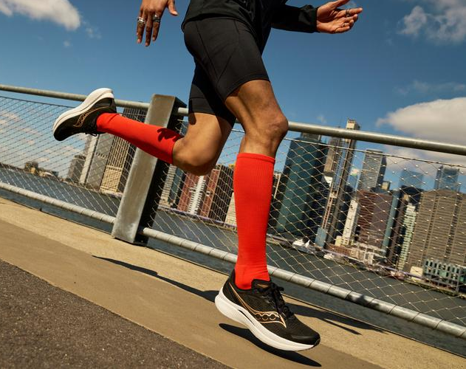

Slide 2
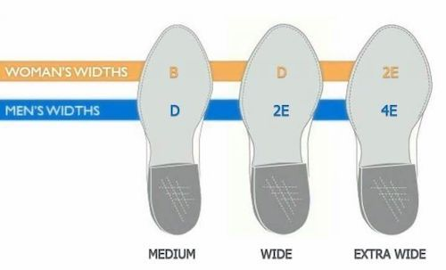
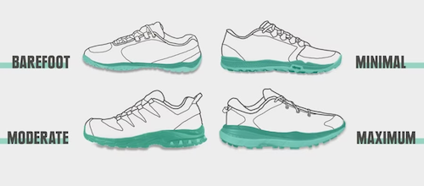
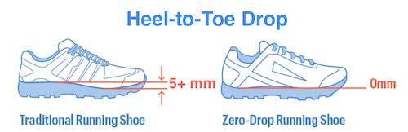
Q1: Who Is Your Customer?
Runners with wide feet who prefer shoes with minimal cushioning and low heel-to-toe drop.

Slide 3
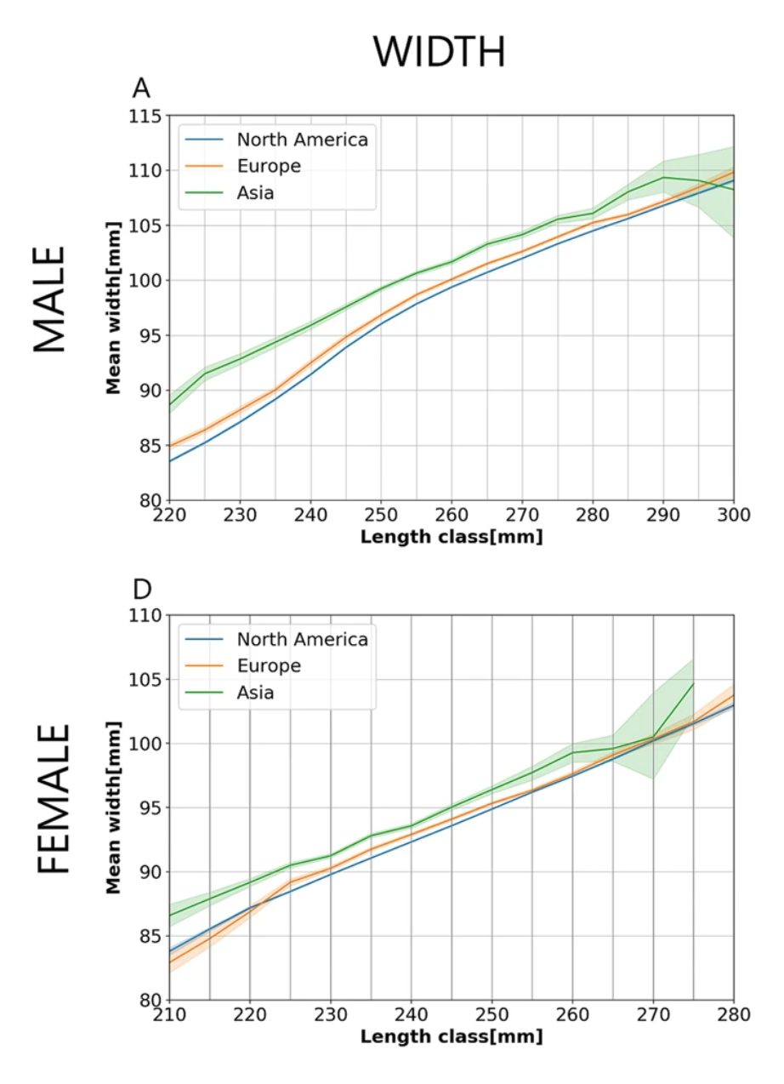
Q1: Who Is Your Customer?
Asian men and women tend to have wider feet than their North American and European counterparts.
Jurca, A., Žabkar, J. & Džeroski, S. Analysis of 1.2 million foot scans from North America, Europe and Asia. Sci Rep 9, 19155 (2019).

Slide 4
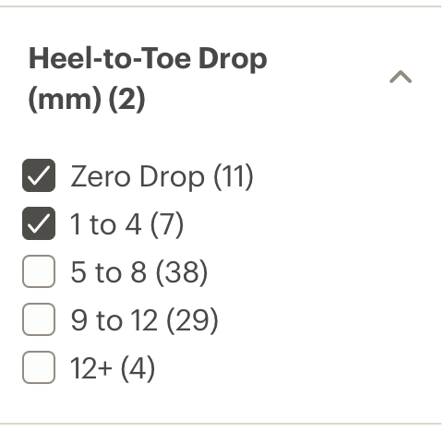
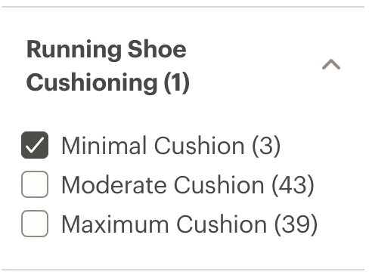
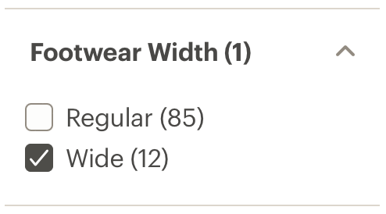
Q2: What Is the Customer Problem?
Limited availability of running shoes with minimal cushioning and low heel-to-toe drop in wide widths.

Slide 5
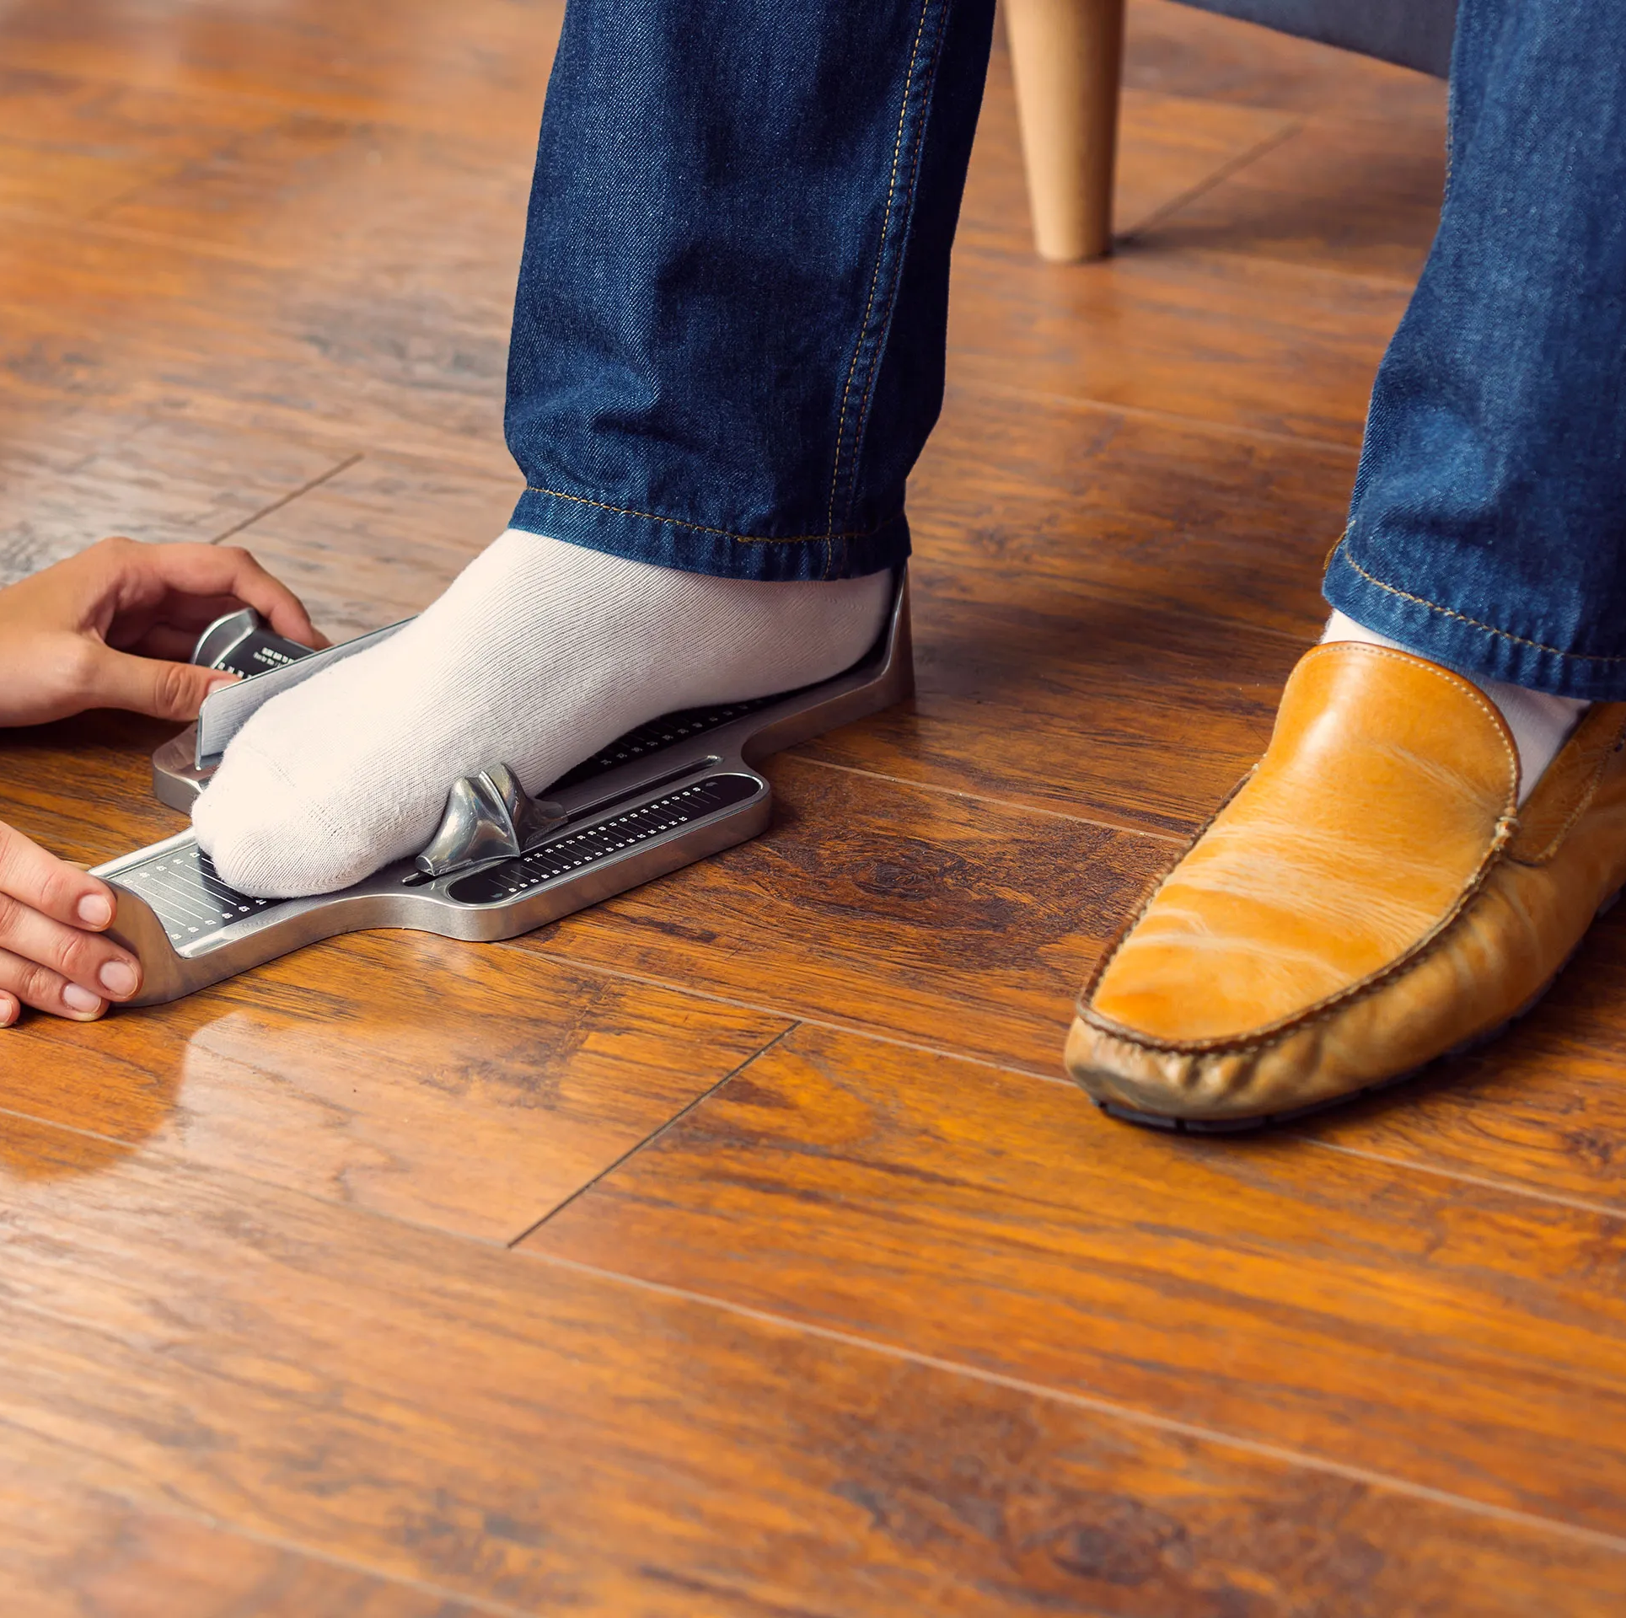
Q3: What Is the Most Important Customer Benefit?
Shoes that fit.

Slide 6
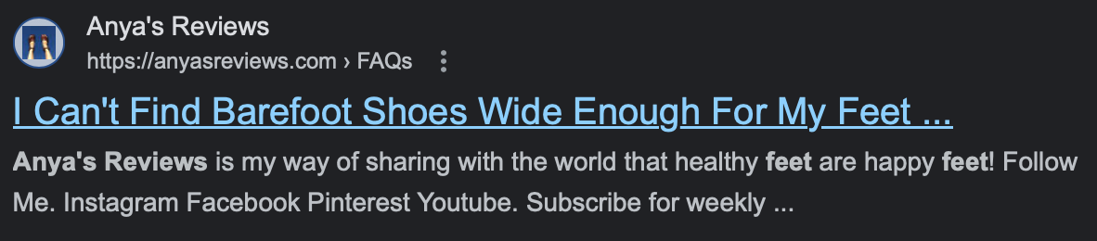
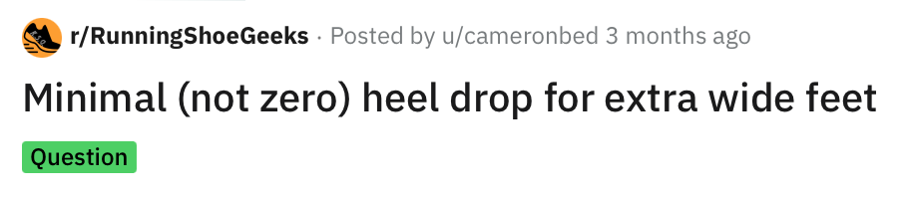
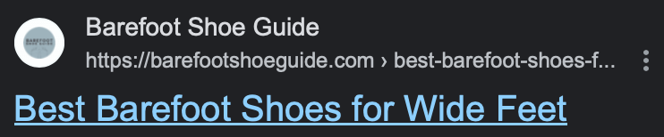
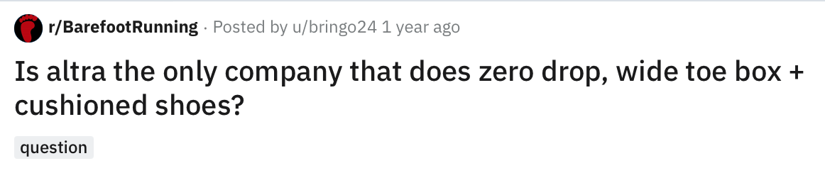
Q4: How Do You Know What The Customer Needs?
Online searches on footwear company and retailer websites, running blogs, and Reddit running forums result in very few wide-width running shoes with minimal cushioning and low heel-to-toe drop.

Slide 7
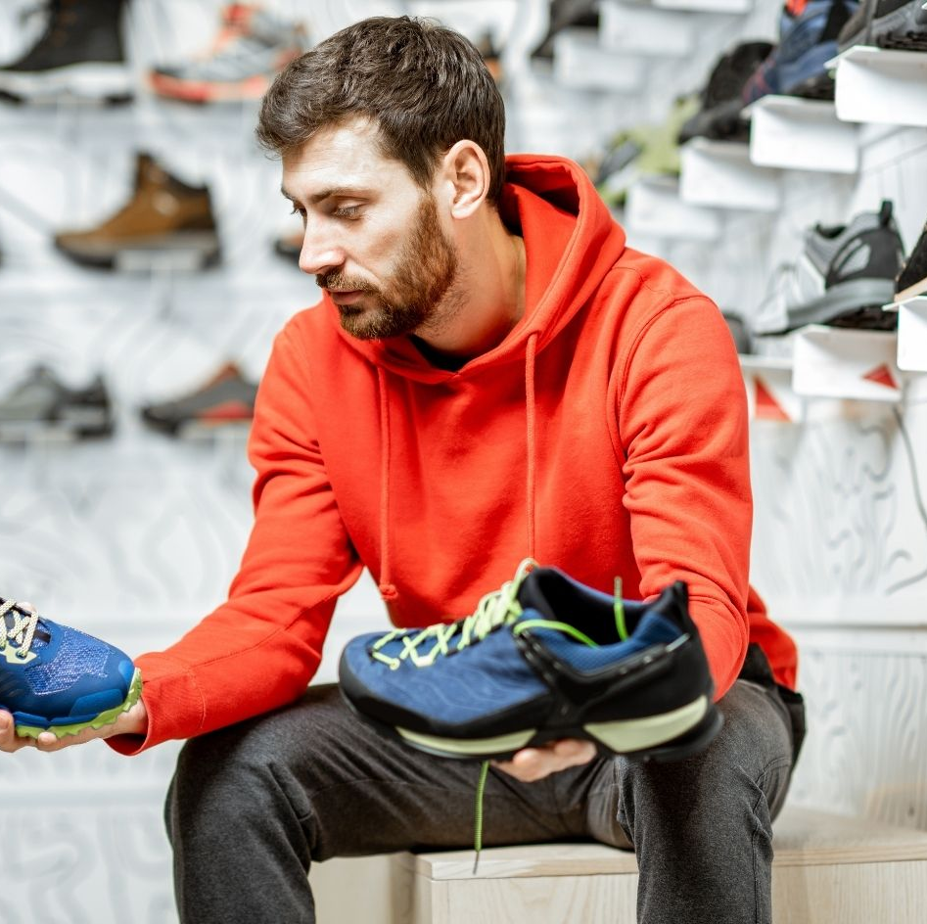
Q5: What Does The Experience Look Like?
Runners with wide feet being able to readily find and purchase wide-width running shoes with minimal cushioning and low heel-to-toe drop.

Slide 8
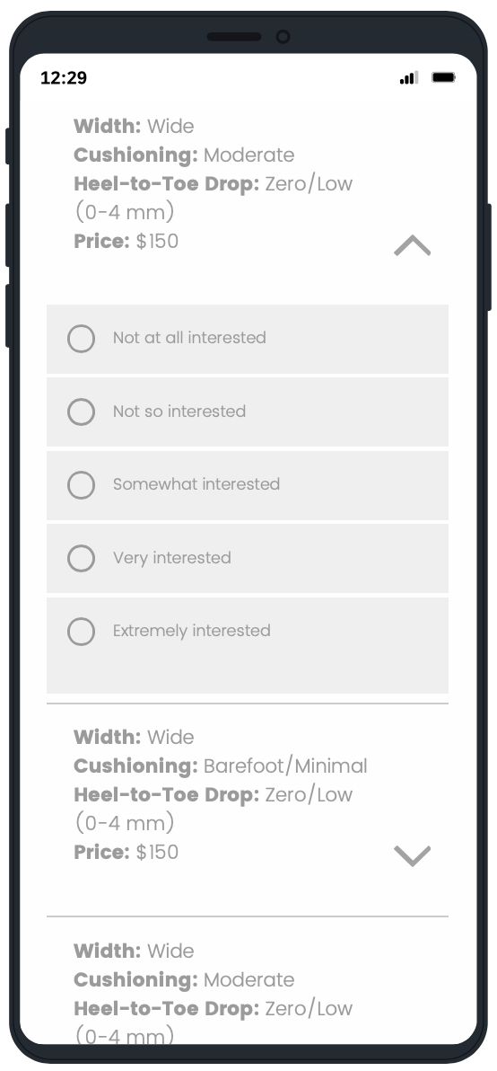
Conjoint Survey
16 different combinations of running shoe features and prices were presented in randomized order.
For each combination, the level of interest in purchasing the shoe was selected from a 5-point Likert scale.
Respondents were friends, family, and sourced from Reddit’s r/SurveyExchange
Qualtrics Survey

Slide 9
Conjoint Survey Limitations
Due to time and budget constraints, accessing a panel of target customers (i.e., runners) was not feasible. Therefore, confidence in the accuracy of the responses was not high due to a lack of familiarity with the features.
Was unable to take a large enough sample where every respondent would only be presented with a smaller random subset of the full set of options. Instead, everyone had to rate all of the options which was not ideal.
Only included two levels from each feature to limit the number of combinations.

Slide 10
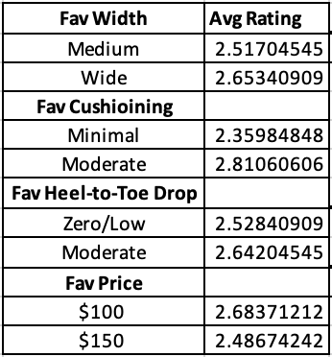
Conjoint Analysis
Combo with the highest average rating:
Width: Medium
Cushioning: Moderate
Heel-to-Toe Drop: Moderate (5+ mm)
Price: $100
Width with the highest average rating:
Wide
Cushioning with the highest average rating:
Moderate
Heel-to-Toe Drop with the highest average rating:
Moderate
Price with the highest average rating:
$100
Running Shoes Survey Conjoint Excel

Slide 11
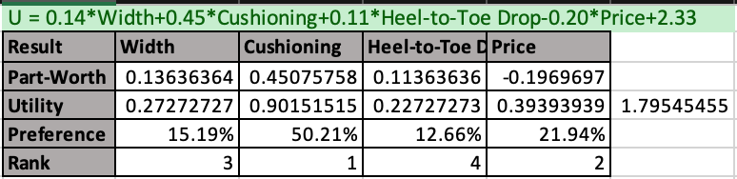
Conjoint Analysis
Utility Function:
U = 0.14*Width + 0.45*Cushioning + 0.11*Heel-to-Toe Drop - 0.20*Price + 2.33
Most preferred feature:
Cushioning
Running Shoes Survey Conjoint Excel

Slide 12
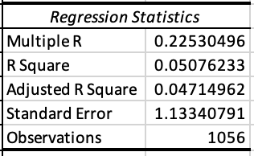
Conjoint Analysis
R² (Coefficient Of Determination) = 0.051
The regression model does not explain much of the variability of the response data around its mean variance. In other words, there is not a strong correlation between the dependent variable and the independent variable
Running Shoes Survey Conjoint Excel

Slide 13
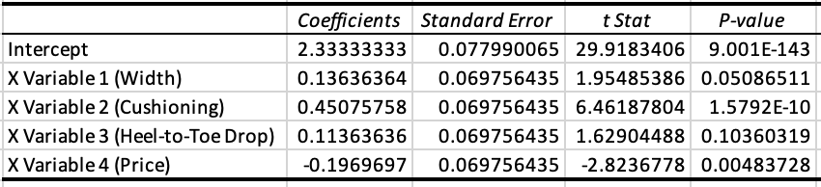
Conjoint Analysis
P-Values (Statistical Significance)
For Width, Cushioning, and Price p<0.05 (reject the Null hypothesis), which means that the results are likely not due to chance alone
However, for Heel-to-Toe Drop p>0.05 (fails to reject the Null hypothesis), which means the results may be due to chance alone
Running Shoes Survey Conjoint Excel

Slide 14
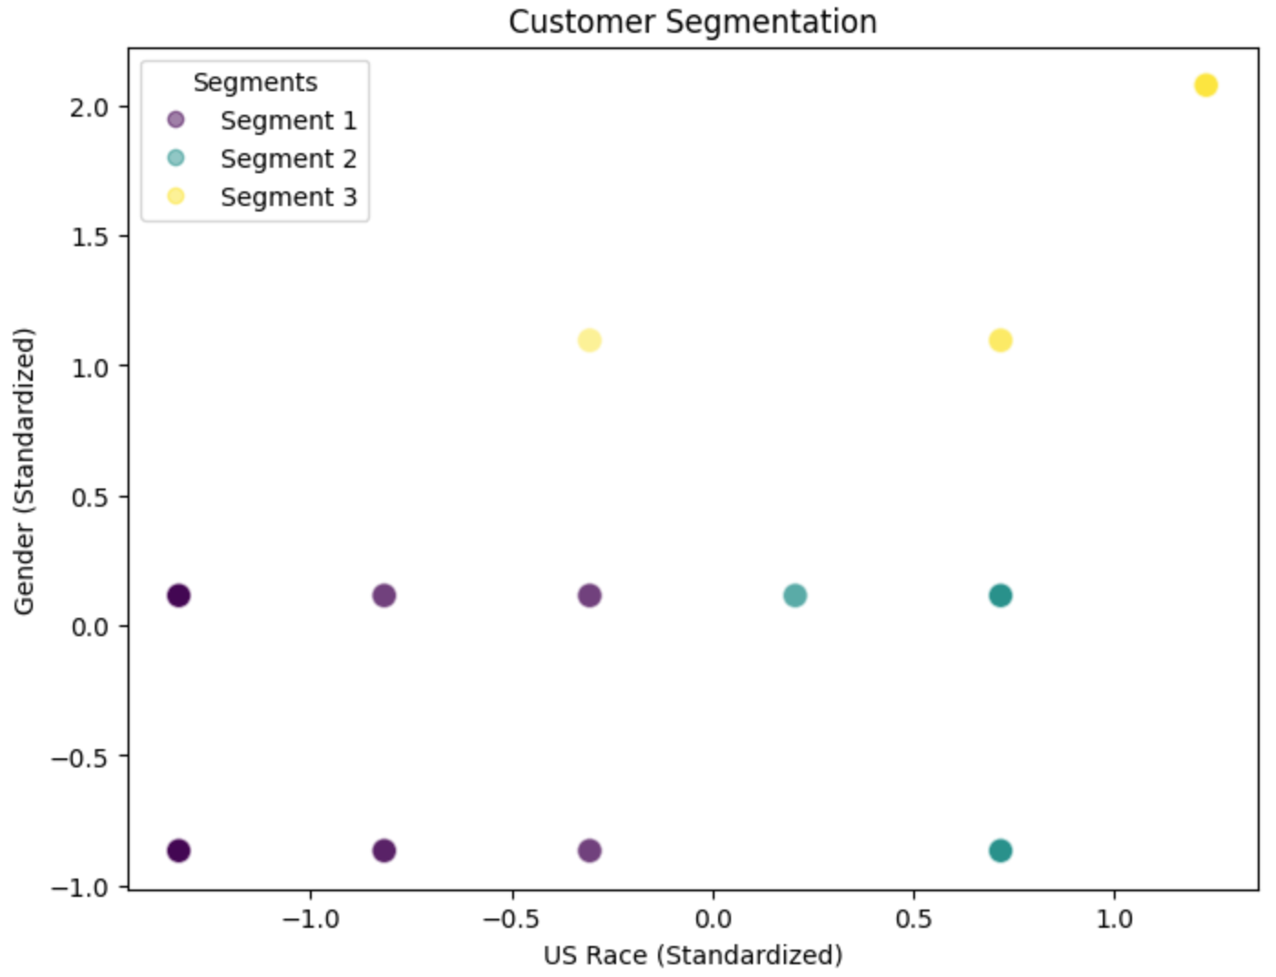
Segmentation
Segment 1: Asian (72%) or Black / African American (16%) AND Male (44%) or Female (56%)
Most preferred combination:
Width: Wide
Cushioning: Moderate
Heel-to-Toe Drop: Zero/Low
Price: $100
K-Means Clustering Python Code

Slide 15
Segmentation
Segment 2: White / Caucasian (94%) AND Male (48%) or Female (52%)
Most preferred combination:
Width: Medium
Cushioning: Moderate
Heel-to-Toe Drop: Moderate
Price: $100
K-Means Clustering Python Code

Slide 16
Segmentation
Segment 3: Preferred not to give their race or gender
Most preferred combination:
Width: Wide
Cushioning: Moderate
Heel-to-Toe Drop, Moderate
Price: $150
K-Means Clustering Python Code

Slide 17
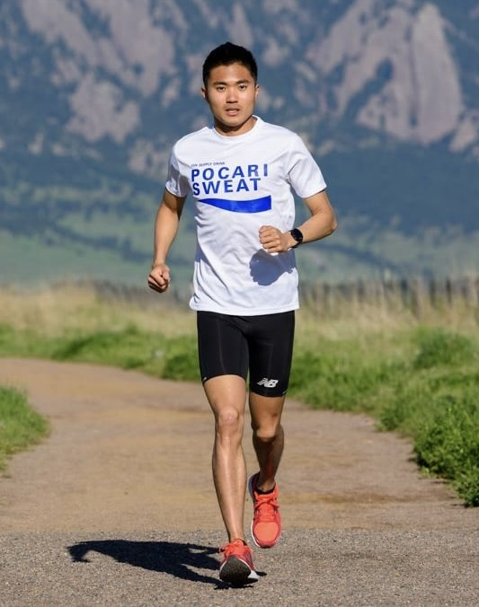
Survey Insights
Survey results show that shoe width is not a significant consideration for most consumers, with cushioning being the most important feature.
Medium-width running shoes are the most popular, especially amongst the White/Caucasian segment.
Results supports the hypothesis that there may be a higher demand for wide width running shoes amongst an underserved Asian segment.

Slide 18
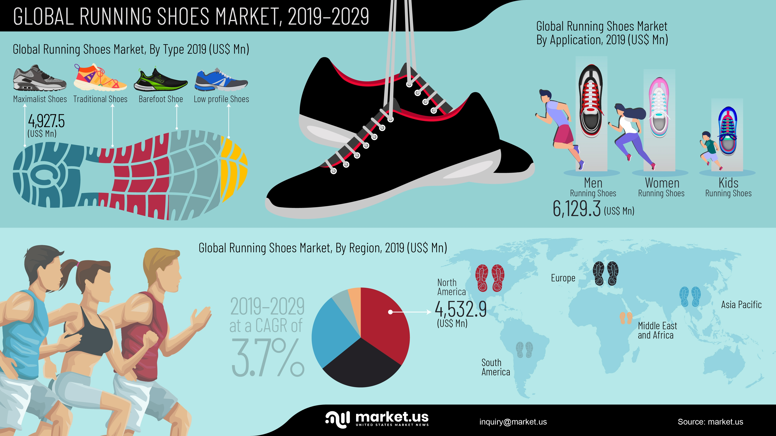
Market Size
Total Available Market (TAM) = 5.6 – 6.24 billion
People who wear shoes and are physically able to run
Served Available Market (SAM) = ~1 billion
People worldwide who purchase running shoes each year
United States market = USD 2.5 billion in 2022
China market = USD 1.5 billion in 2022
Target Market = 1.6 million
People of Asian descent in the United States who buy running shoes each year
Source: Google Bard

Slide 19
GitHub Files
https://github.com/nicholaslwong/MKTG.X413.-14-Consumer-Insights-Data-Analysis-and-Interpretation.git

